Slide 1
Internship Tableau Worksheet
File created on: 06-08-2024 12:25:00

Slide 2
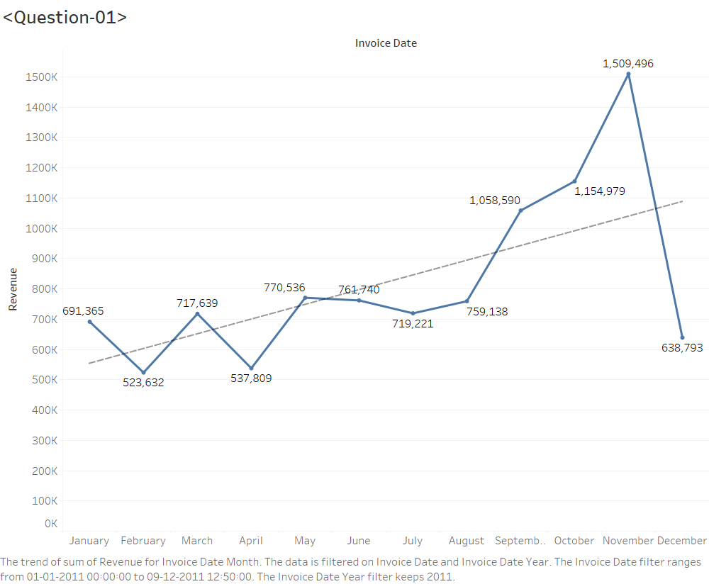

Slide 3
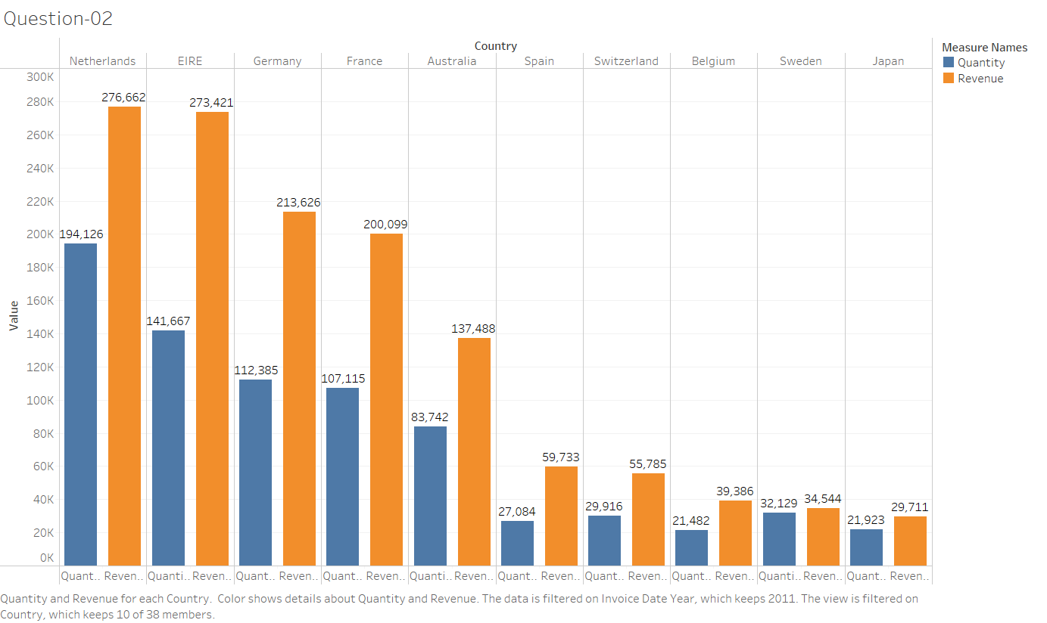

Slide 4
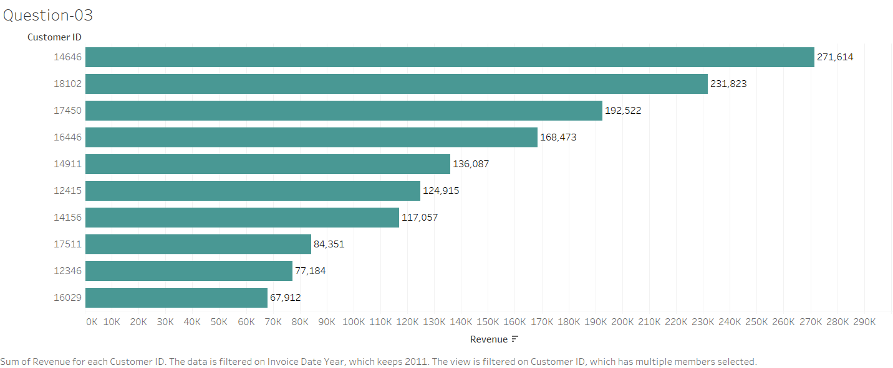

Slide 5
